Slide 1
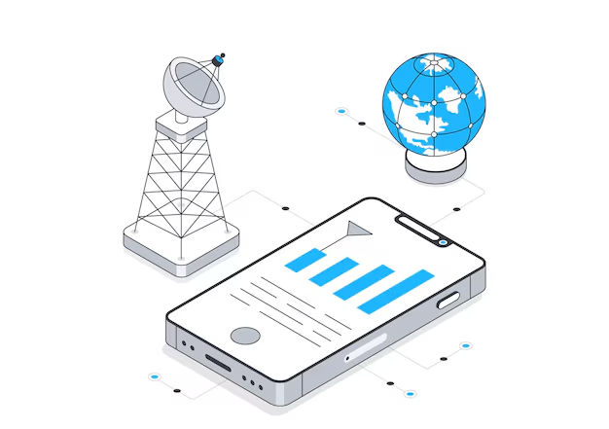
Mobile And Wireless Networks
CS8013
Instructor: Dr. Vinod Kumar Jain

Slide 2
Secured Internet Office Network with the Internet of Things Using Packet Tracer Analysis
Authors: Azrai Danial Azhari, Norakmar Arbain Sulaiman, Murizah Kassim
Publisher: 2021 IEEE 11th International Conference on System Engineering and Technology (ICSET
2021), 6 November 2021, Shah Alam, Malaysia

Slide 3
Need
1. Underutilization of IoT in Office Environments
IoT technology, widely adopted in residential spaces, has seen slower implementation in corporate and business sectors. This delay limits their ability to benefit from smart systems, including enhanced security, automation, and operational efficiency.
2. Security Concerns in IoT networks
IoT integration introduces vulnerabilities, as interconnected devices can be exploited.
Thus we aimed to to develop a scalable, secure and functional office IoT network.

Slide 4
Objective
3. Key Objectives:
Integration of IoT Systems: Incorporate practical IoT systems in small office networks
1. Motion detection
2.Door Lock System
3.Smoke detection.
Enhancing Network Security: Implement advanced security protocols such as SSL-VPN, ASA Firewall security levels, and WPA2-PSK with AES encryption to counter IoT-related vulnerabilities.
Simulation and Testing: Use Cisco Packet Tracer to design, simulate, and validate the proposed network's performance and security under various scenarios.

Slide 5

Key Technologies Used
Cisco ASA Firewall, SSL VPN, WPA2-PSK authentication.
VLAN to provide communication between grouped devices and enhance the management of network traffic.
DHCP for automated assignment of the IP Address.
Registration Server to manage and configure IoT devices in office network.
A Tree Topology was selected for its flexibility, scalability, and ease of fault isolation. This design facilitates the addition of nodes without significant structural impact and simplifies troubleshooting.

Slide 6
Methodologies
1) Designing Network Topology and Specification
Devices Used:
Cisco ASA 5505 Firewall: Serves as the central security component for network traffic control.
Router Model 2621XM: Enables network communication with external environments.
Switch Model 2960-24TT: Connects internal network devices.
Servers: Registration server, HTTP access and Google Server.
End devices: Include PCs, IoT devices, and Access Points for IoT system implementation.

Slide 7
Methodologies
1) Designing Network Topology and Specification
IoT Systems Integrated:
Motion Detection System: Comprises motion detector , alarm, and webcam to
monitor and respond to unauthorized movement.
Door Lock System: Employs an RFID reader and smart door for secure access
control management. Door unlocks only at RFID 1001 otherwise it is locked.
Smoke Detection System: Incorporates a smoke detector, fire sprinkler
and alarm for fire prevention and safety. When Smoke detector reading is more
Than 0.4 ppm then only fire alarm and fire sprinkler are active.

Slide 8

Methodologies
2) Network Configuration
Cisco ASA Firewall: It is the main component of our network.
Performs dhcp assignment to all the devices in network, Vlan segmentation and manages the security levels of inside and outside network. Security level of inside
Vlan 1 is 100 and outside Vlan 2 is 0.
Traffic Rules:
Traffic flow from a higher-level security interface to a lower-level security interface is permitted.
Traffic flow from a lower-level security interface to a higher-level security interface is not permitted.
Traffic flow is prohibited from any interface to any other interface with the same security level.
Traffic flows in and out from the same interface are also denied.

Slide 9
Methodologies
HTTP SERVER :
Provide SSL VPN is a technology that allows secure, limited access to internal network
resources from any location using a web browser. No specific VPN client is required; a
remote user only needs a device with an SSL-enabled web browser to access HTTP or
HTTPS-enabled web servers on the internal network.
REGISTRATION SERVER:
Used to manage and configure all the iot devices in the network.

Slide 10
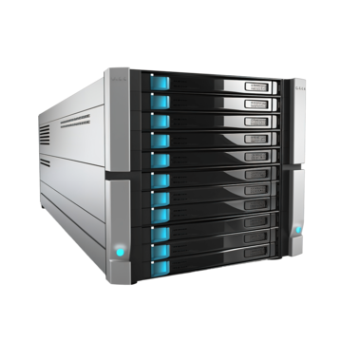
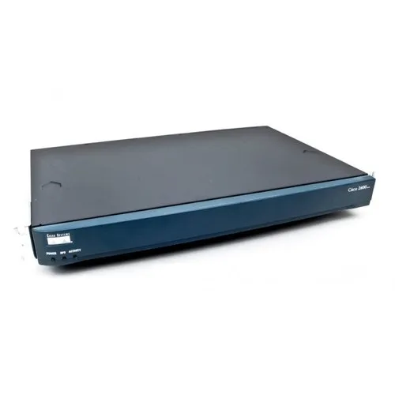
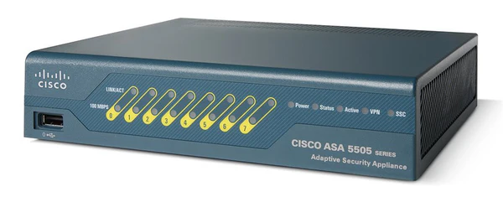
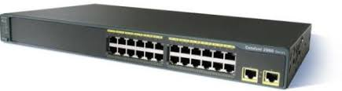
Steps associated with project development
1. Created a network topology with these devices
- Router (2621XM)
- ASA 5505 Firewall
- Switch (2960-24TT)
- 2 PCs (Admin PC and User PC)
- 3 Servers (HTTP Server, IoT Registration Server and Google Server)
- 3 Access Points (Motion AP, Door AP, Smoke AP)
- IoT devices for each system
Router (2621XM)
ASA 5505 Firewall
Switch (2960-24TT)
Server

Slide 11
Steps associated with project development
2. Commands at CLI of ASA firewall to create Vlan 1 and Vlan2 and also assigned dhcp to all the network devices
en
conf t
int vlan 1
nameif inside
security-level 100
ip address 192.168.1.1 255.255.255.0
dhcpd address 192.168.1.3-192.168.1.33
dhcpd dns 8.8.8.8
no shut
int vlan 2
nameif outside
security-level 0
…………
…………
ip address 50.1.1.2 255.255.255.0
no shut
interface ethernet 0/1
switchport access vlan 2
no shutdown
interface ethernet 0/0
switchport access vlan 1
no shut
route outside 0.0.0.0 0.0.0.0 50.1.1.1
wr me

Slide 12
Steps associated with project development
3. Commands at router 2621XM
en
conf t
interface Fa0/0
ip address 50.1.1.1 255.255.255.0
no shut
interface Fa0/1
ip address 8.8.8.1 255.255.255.0
no shut
ip route 168.192.1.1 255.255.255.0 50.1.1.2
ip route 0.0.0.0 0.0.0.0 8.8.8.8
wr me

Slide 13
Steps associated with project development
4. Commands for Google server configuration
ip address 8.8.8.8
subnet mask 255.255.255.0
default gateway 8.8.8.1
5. Commands for HTTP server configuration
ip address 192.168.1.100
subnet mask 255.255.255.0
default gateway 192.168.1.1
DNS server 8.8.8.8

Slide 14
Steps associated with project development
6. Commands for Registration Server configuration
ip address 192.168.1.101
subnet mask 255.255.255.0
default gateway 192.168.1.1
DNS server 8.8.8.8
7. Commands for Switch(2960-24TT) configuration
en
conf t
interface vlan 1
ip address 192.168.1.2 255.255.255.0
no shut
………
………
ip default-gateway 192.168.1.1
interface range Fa 0/1-24
switchport mode access
switchport access vlan 1
no shut
wr me

Slide 15
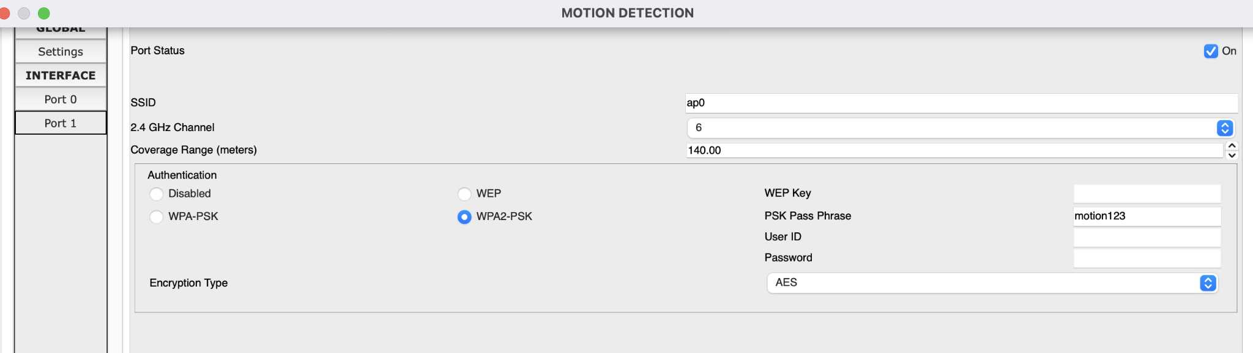
Steps associated with project development
8. WPA2-PSK security enabling in access points

Slide 16
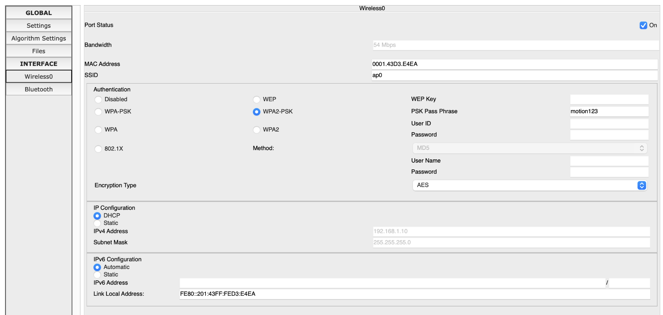
Steps associated with project development
9. WPA2-PSK enabling at iot devices

Slide 17
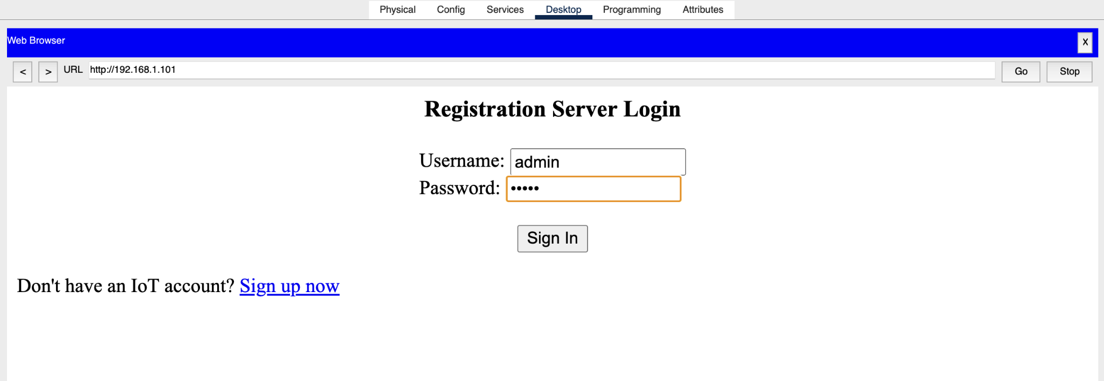
Steps associated with project development
10. Admin registration login window

Slide 18
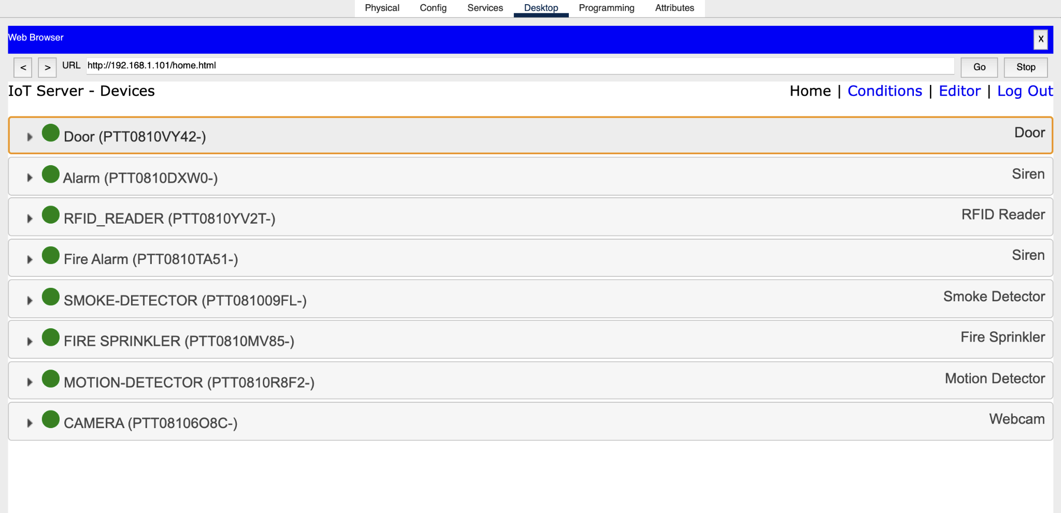
Steps associated with project development
11. Connected Iot devices inside registration server

Slide 19
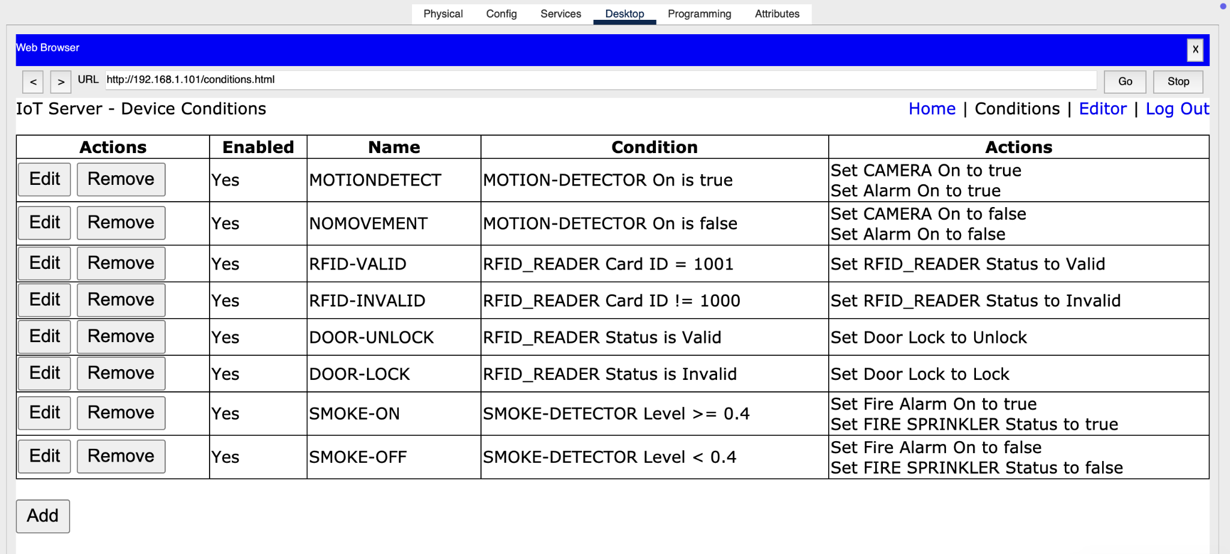
Steps associated with project development
12. Logic Enabled within iot devices

Slide 20
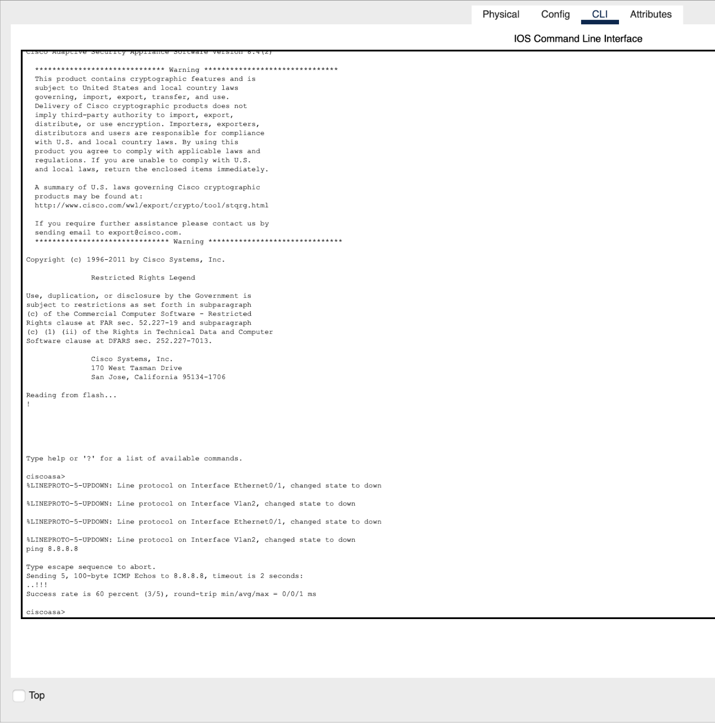

Steps associated with project development
13. Security testing from internal network to external, ping to Google server 8.8.8.8 from Cisco ASA firewall

Slide 21
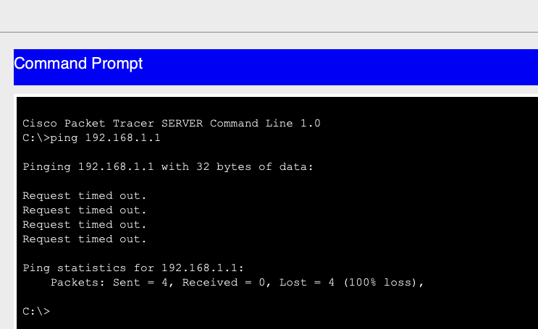

Steps associated with project development
14. Security testing from external network to internal network, pinging internal network from google server

Slide 22
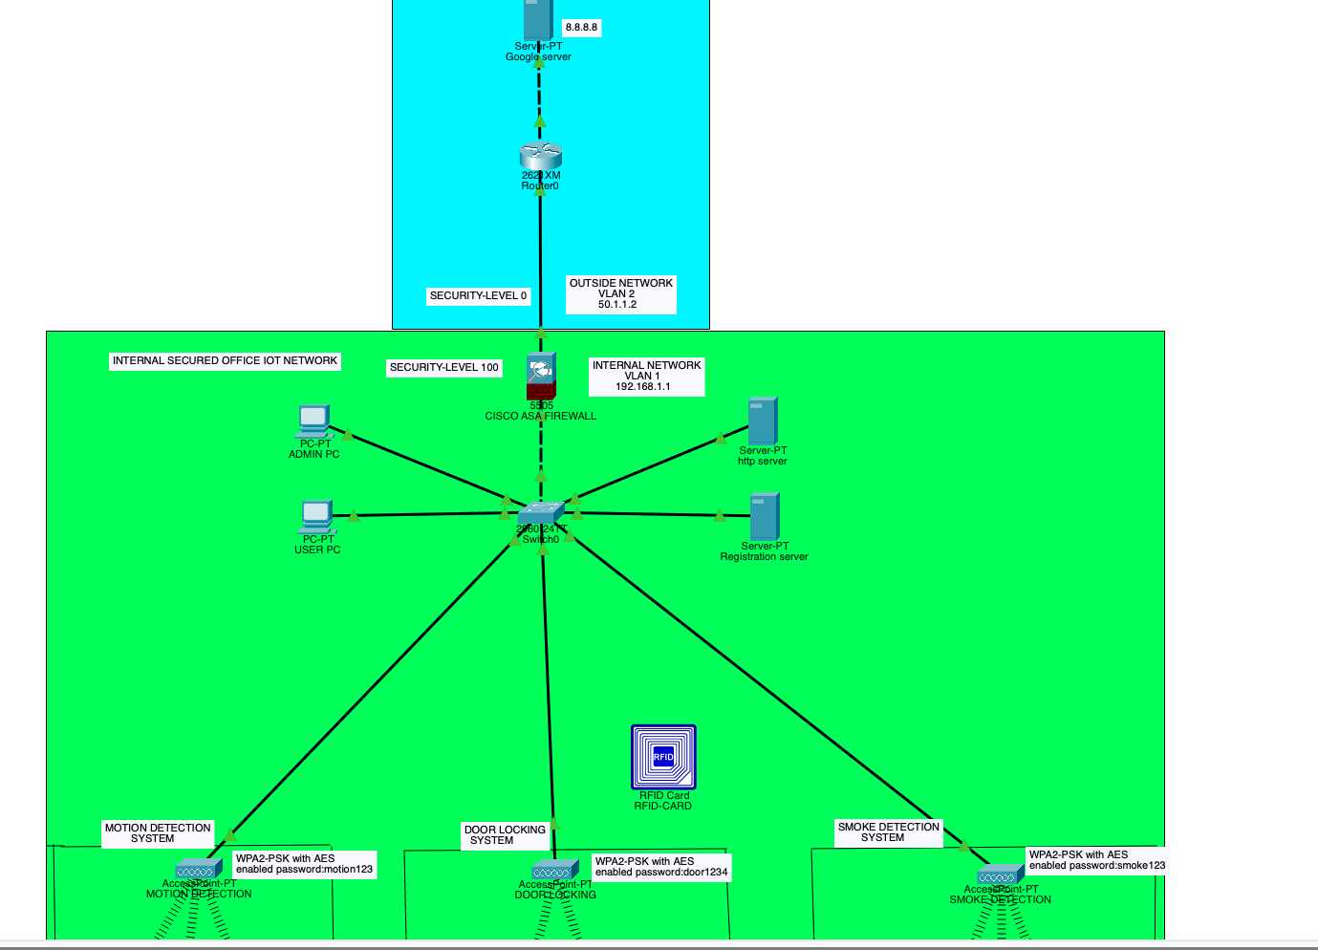
Final Topology

Slide 23
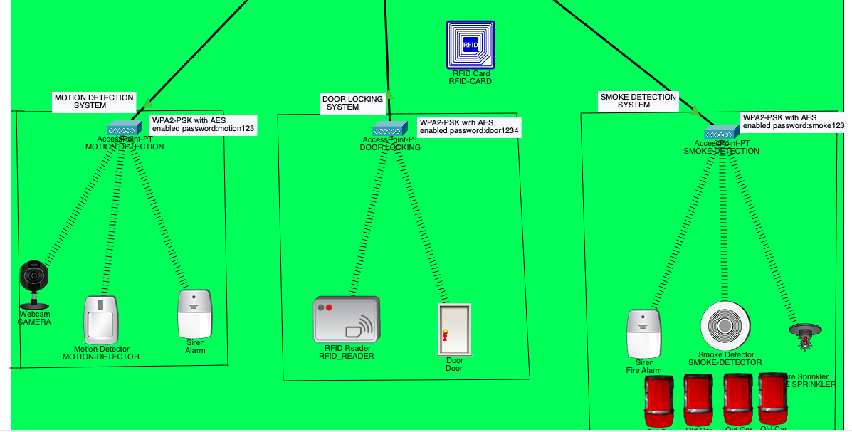
Final Topology

Slide 24
Final Results
Motion detection system has been successfully implemented and working as intended When Motion is Detected by motion detector it activates the alarm and camera to capture the image of person who is trespassing the office.
Door Locking System has been successfully implemented and door is unlocking only RFID is 1001 else door remain unlocked.
Smoke detection system has been successfully implemented. When smoke level >=0.4 Then only smoke detector activates fire alarm and fire sprinkler. Smoke detection curve PPM vs Time.

Slide 25
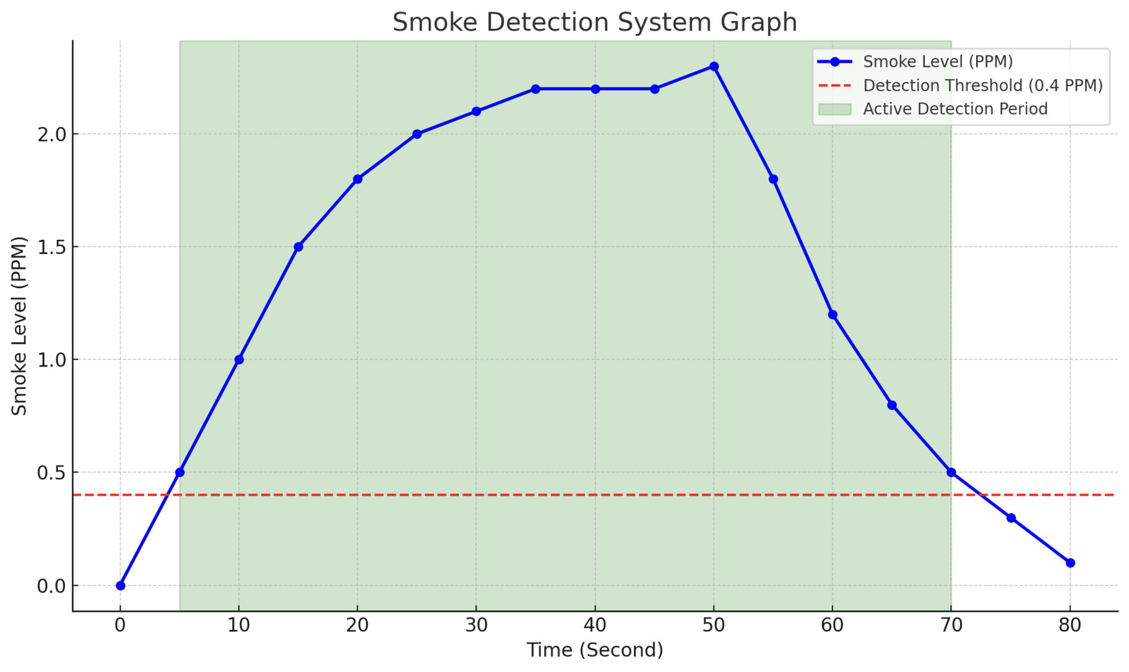

Slide 26
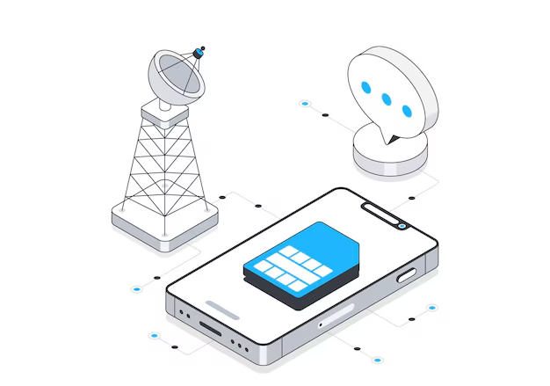
Thank You

